Slide 1



Team Dynamics
The Decline of Birth Rates in South Korea
Javlonbek 12194926
Shokirjon 12194867
Jakhongir 12210220

Slide 2


Overview
Introduction
01
Discussion
02
Population Forecasting and implementation
03
Statistics
04
Data analysis tools
05
Survey
06
Conclusion
07

Slide 3

Introduction
This topic is important as it has impact on South Korean economy.
Because it may cause labor shortages, economic unstability.
Our team tryies to raise public awareness such as educating Society and Community Engagement.

Slide 4



Discussion
Although the Korean government has constantly increased the budget for solving the low fertility issue, the fertility rate has gradually decreased.
Accordingly, it stated that the life courses of both men and women were transformed into labor-based life courses. People in their 20s and 30s witnessed the rapid dissolution of norms associated with marriage or the gender role in their families.

Slide 5
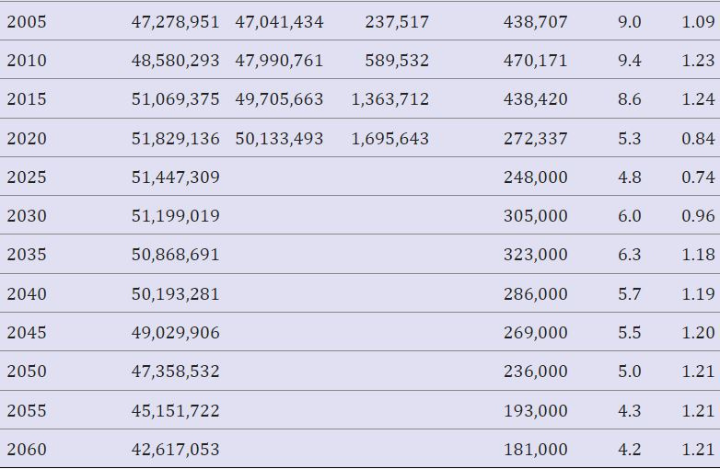
Population Forecast
Total population
Koreans
Foreigners

Slide 6
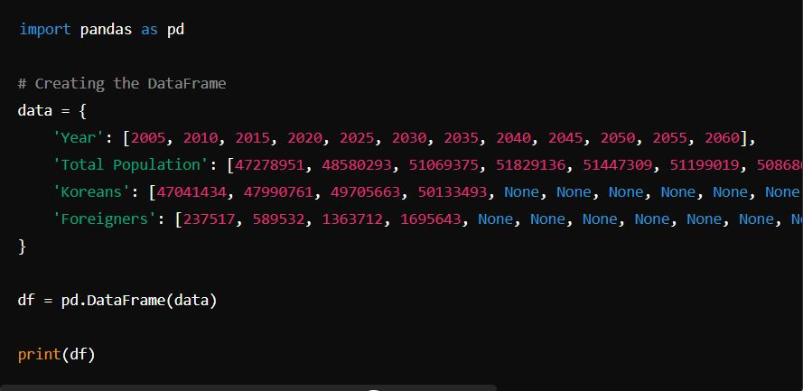
Create a Data Frame

Slide 7
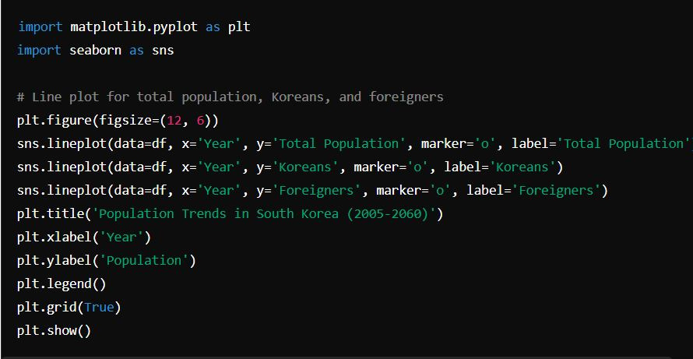
Plotting the Data

Slide 8


STATISTICS
The Decline of Birth Rates in South Korea

Slide 9


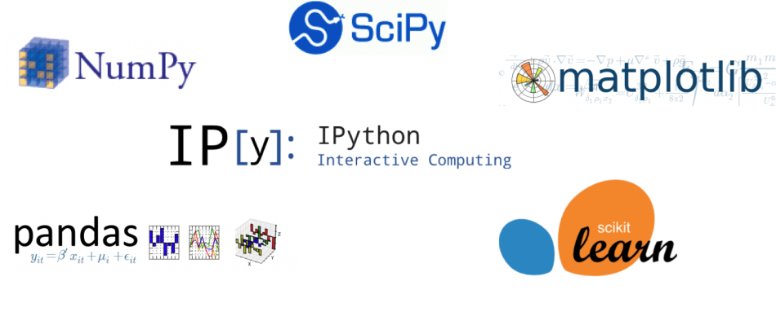

Data analysis Tools:
Python
Matplotlib
Numpy
Jupyter
Objective 01

Slide 10
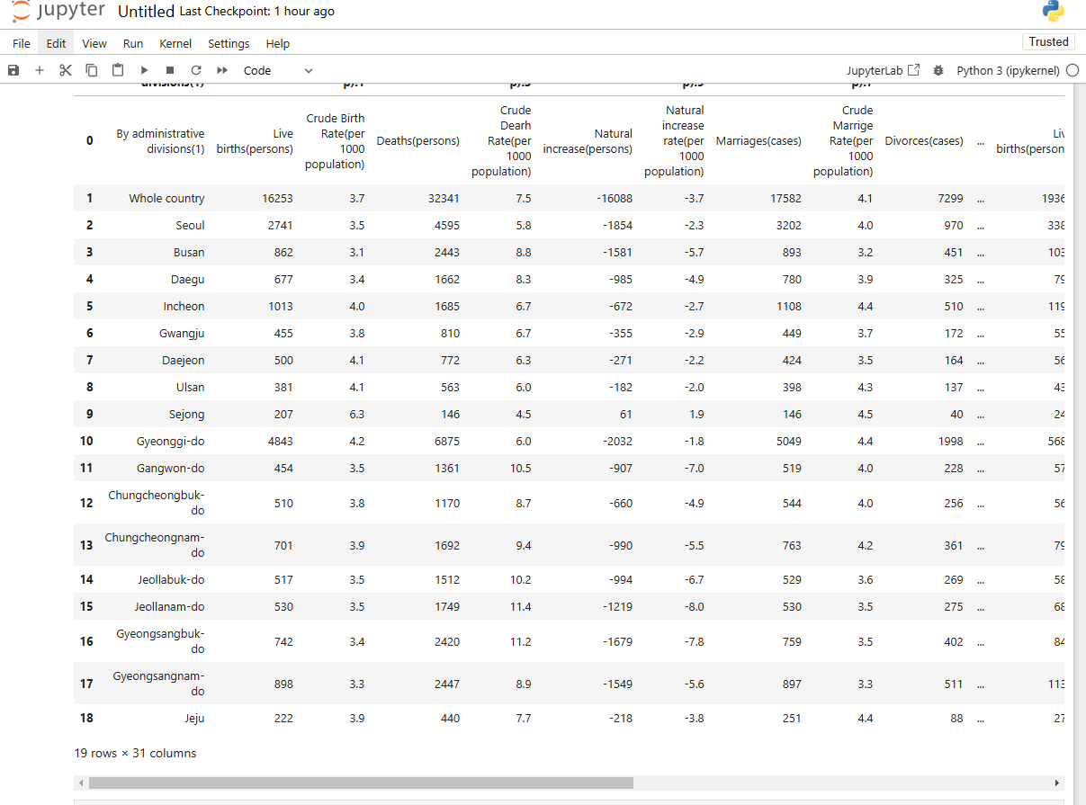
STATISTICS

Slide 11
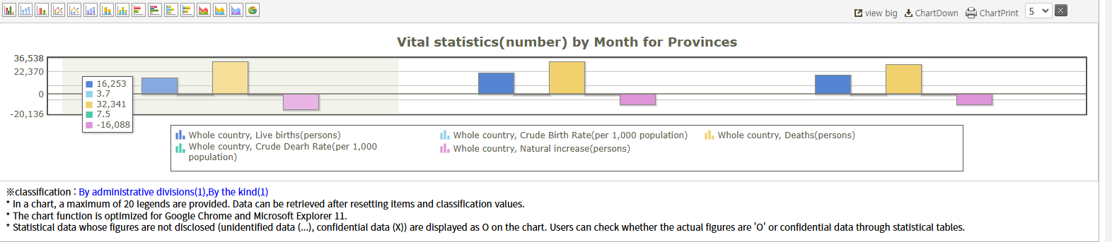
STATISTICS

Slide 12
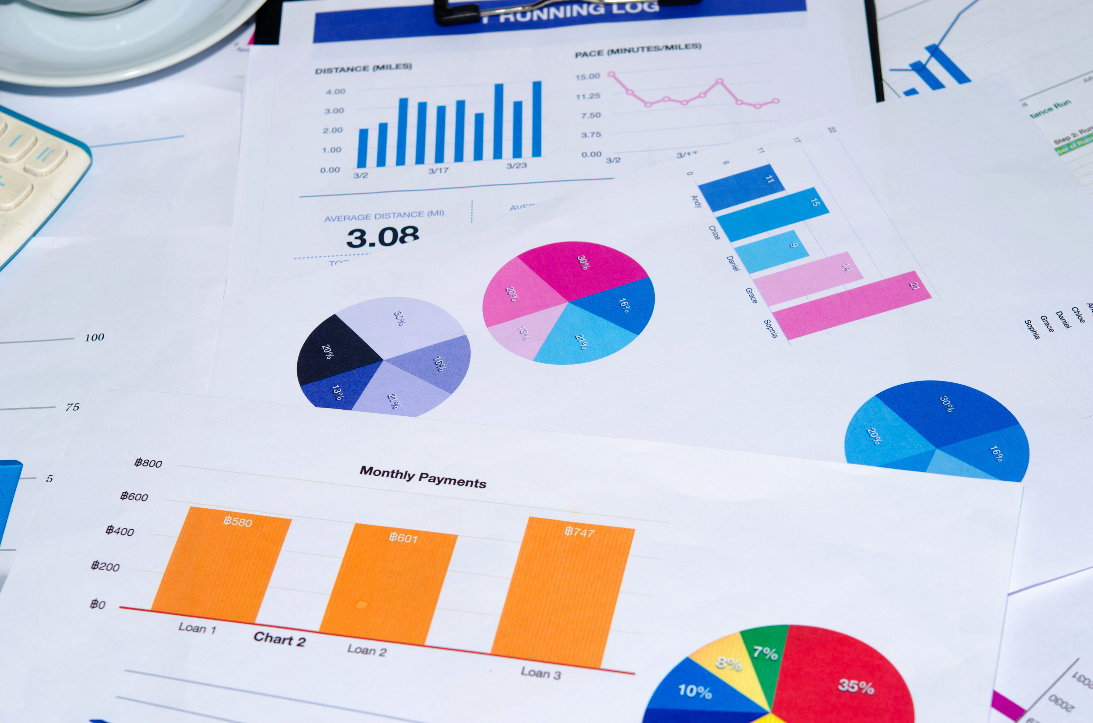
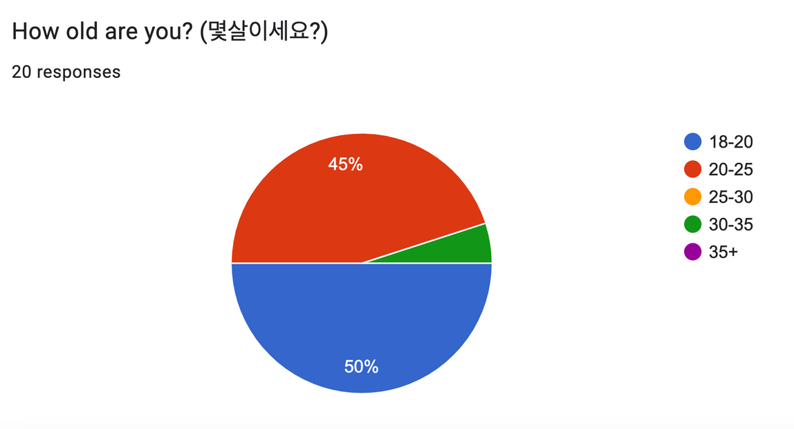
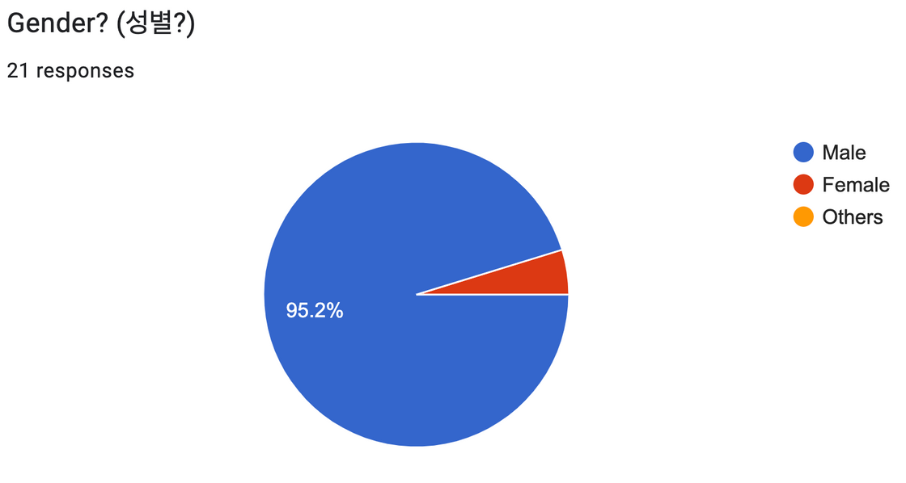
Google Form Survey results

Slide 13
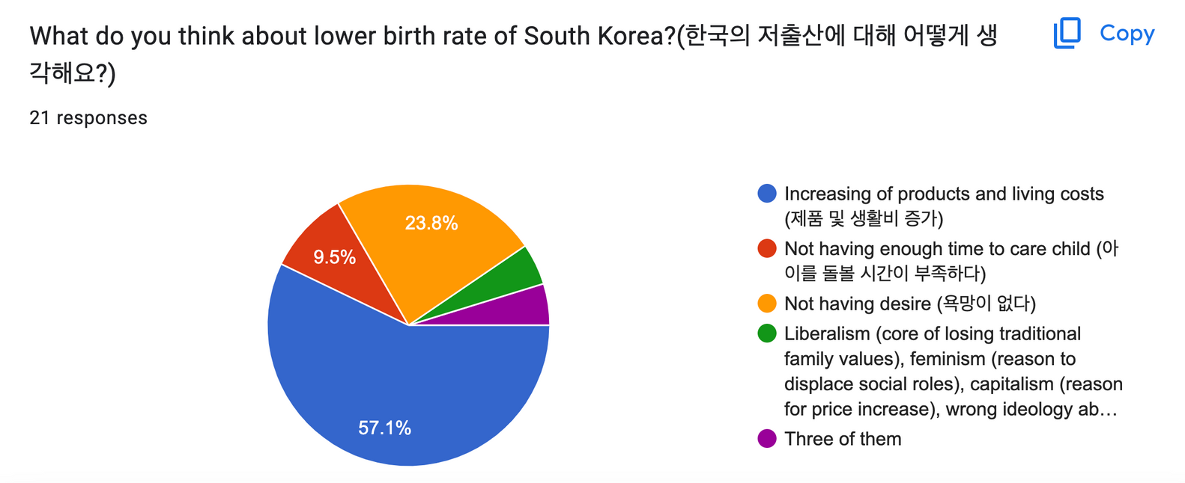
Google Form Survey results

Slide 14


Working with problems by government
As Korean citizens do not have enough time, the Korean government doing a “new project” that brings 100 caregivers from the Philippines. at the end of July.

Slide 15


Living together but not having baby...
Some Koreans do
not want to have a
baby even though
they are dating...
They afraid of caring and some portion of them want to care about their career. That’s why government worries about the future...

Slide 16


Team Dynamics
THANK YOU!
If you have any questions, feel free to ask!

